Slide 1




ONLINE FOOD DELIVERY SYSTEM
BhojanGo
Customer
Street food, straight to your door.
TEAM MEMBERS
[P.Charan Sainadh , Ch.Yaswanth Sai , M.Yoga Bharath]
ROLL NUMBERS
[2500032280 , 2500030953 , 2500032646]
SECTION
[Section - 63]
COURSE
[FrontEnd Frameworks and Web Development]
FACULTY
Under the guidance of LALITHA VANI SREE
DEPARTMENT
Computer Science
UNIVERSITY
KL University
Stall
Rider

Slide 2

01
OVERVIEW
Problem Statement | Proposed Solution

Slide 3



01 · OVERVIEW
Problem Statement
1
Customers need a convenient way to discover local food stalls and menus.
2
Customers need a simple digital ordering and checkout experience.
3
Customers require visibility into preparation and delivery status.
4
Food vendors need a lightweight way to receive and view orders.
5
Delivery information (rider, ETA, contact) must be available throughout the order lifecycle.
BhojanGo | Online Food Delivery System
3

Slide 4

01 · OVERVIEW
Proposed Solution — BhojanGo
Browser-based frontend application that simulates a complete food-ordering flow connecting customers, stalls, and riders.
STEP 1
STEP 2
STEP 3
STEP 4
Browse Stalls
Select Food
Checkout
Delivery
Explore available vendors and menus
Choose dishes and customizations
Review order and confirm details
Rider delivers order to customer
KEY POINT
The app demonstrates end-to-end order flow entirely in-browser (simulated payment & delivery).
BhojanGo | Online Food Delivery System
4

Slide 5

02
SYSTEM DESIGN
Modules | Food Discovery | Cart & Payment | Order Tracking | Authentication

Slide 6
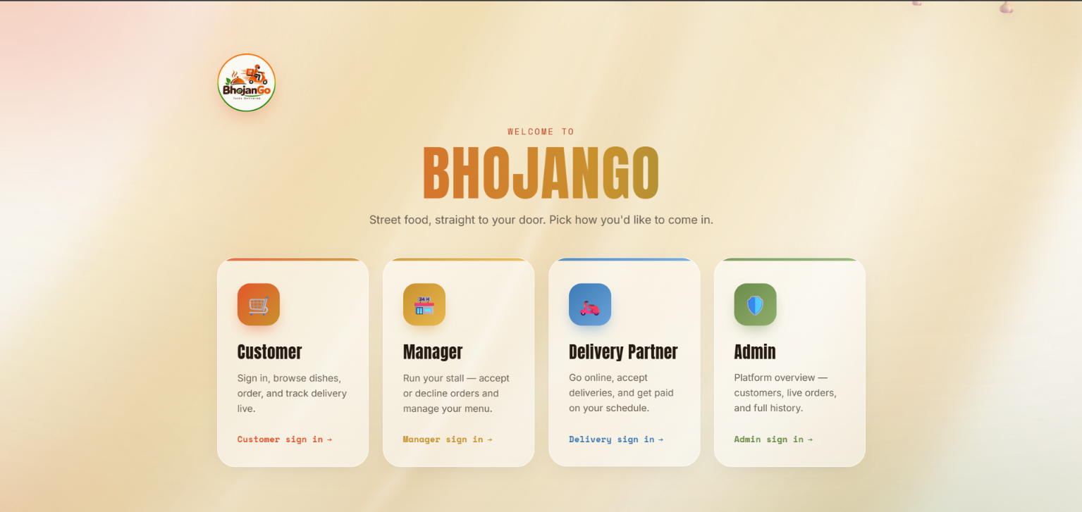

Slide 7
02 · SYSTEM DESIGN
System Modules
Customer Module
Restaurant Partner Module
Restaurant signup
Restaurant login
Manage restaurant details & address
Customer sign in (demo)
Phone / OTP demo authentication
Address selection (map picker)
Browse stalls & dishes
Veg / Non-veg filtering
Cart, Checkout, Payment (simulated)
Order tracking
Delivery Functionality
Rider assignment (simulated)
Rider information (name, contact)
ETA display
Call/message links (frontend)
BhojanGo | Online Food Delivery System
6

Slide 8
02 · SYSTEM DESIGN
Food Discovery
STALLS
DISHES
FILTERS
9
122
Veg / Non-veg
9 food stalls indexed by name and cuisine. Stall-based menus for easy browsing.
122 dishes with images, descriptions, and price information.
Veg / Non-veg toggles and simple search for quick filtering.
BhojanGo | Online Food Delivery System
7

Slide 9
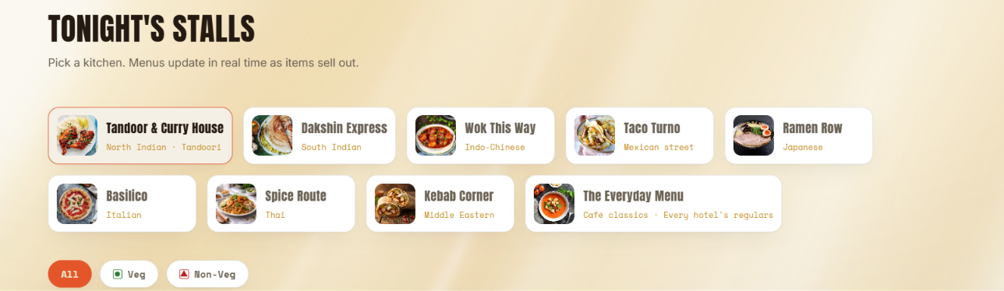

Slide 10


02 · SYSTEM DESIGN
Cart, Checkout & Payment
USER FLOW
IMPLEMENTED PAYMENT OPTIONS (SIMULATED)
Select item → Add to cart
1
Pay Online
Cash on Delivery
Open cart → Update quantities
2
QR code (frontend simulation)
IMPORTANT
Payments are simulated in the browser — no real payment processing.
Checkout → Confirm address
3
Payment → Simulated options
4
BhojanGo | Online Food Delivery System
8

Slide 11



02 · SYSTEM DESIGN
Order Tracking
1
Placed
2
Preparing
3
Out for Delivery
4
Delivered
Order confirmed; kitchen ticket generated.
Kitchen-ticket status shows items being prepared.
Rider assigned with ETA and contact details.
Order completed; delivery timestamp recorded.
BhojanGo | Online Food Delivery System
9

Slide 12
02 · SYSTEM DESIGN
Authentication & Address
Customer Flow
Restaurant Partner Flow
Name + Phone
Signup
↓
↓
Demo OTP
Enter restaurant details
↓
↓
Address selection
Address
↓
↓
Customer session
Login
Map-based address picker (requires internet)
Session stored in Local Storage
Restaurant accounts kept in Local Storage (demo)
BhojanGo | Online Food Delivery System
10

Slide 13

03
TECHNOLOGY
HTML | CSS | JavaScript | Local Storage |

Slide 14




03 · TECHNOLOGY
Technology & Implementation
HTML
CSS
JavaScript
Application structure and semantic markup.
Styling using CSS Grid and Flexbox for responsive UI layout.
Client-side logic: authentication (demo), navigation, cart, checkout, order tracking.
Local Storage
Browser-side persistence for:
Customer information
Restaurant accounts & sessions
Cart and order state
BhojanGo | Online Food Delivery System
12

Slide 15

04
CONCLUSION
Current System & Future Scope | Key Takeaways

Slide 16



04 · CONCLUSION
Conclusion & Future Scope
Current System (Implemented)
Future Scope
Food-stall discovery (9 stalls, 122 dishes)
Backend & database integration for persistent data
Dish pages with images and filters
Real authentication & OTP service
Cart, checkout, simulated payment
Real payment gateway integration
Customer authentication (demo) & address picker
Real-time GPS rider tracking & push notifications
Order tracking, rider assignment (simulated)
Restaurant order-management backend and reporting
Restaurant partner signup/login and details
Centralized Admin dashboard
KEY POINT
Current features are implemented; future scope lists realistic, planned enhancements.
BhojanGo | Online Food Delivery System
14

Slide 17
SUMMARY
Key Takeaways
1
BhojanGo simulates a complete food-ordering flow in the browser, connecting customers, stalls, and riders.
2
Food discovery covers 9 stalls and 122 dishes, with Veg / Non-veg filters and simple search.
3
Cart, checkout, and simulated payment (QR code or Cash on Delivery) complete the ordering journey.
4
Order tracking moves through Placed, Preparing, Out for Delivery, and Delivered, with rider details and ETA.
5
Future scope: backend and database, real authentication and payments, GPS tracking, and an admin dashboard.
15

Slide 18
BHOJANGO
Thank You
Questions?
Street food, straight to your door.

